Slide 1
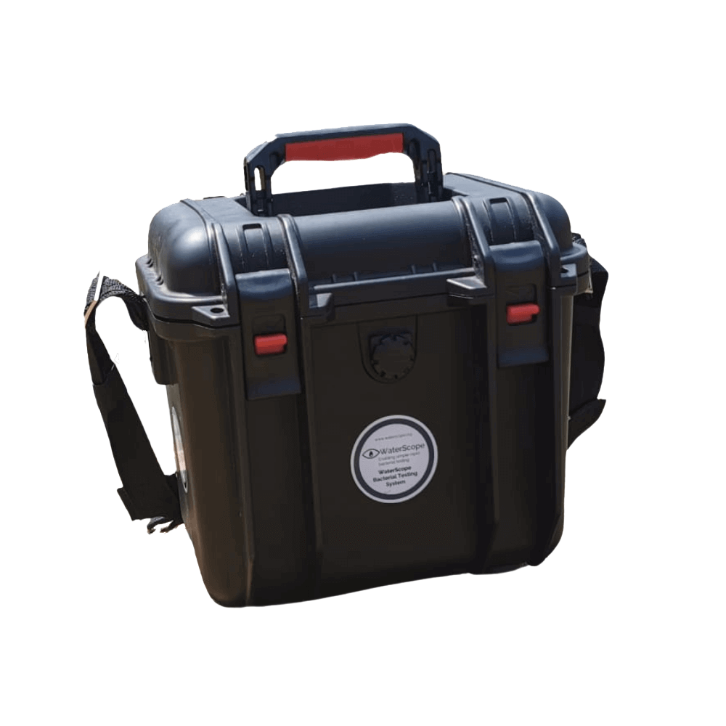
WaterScope Africa
Transforming Water Quality
Presented by Yohannes Tamiru
Canada-Africa Academic Collaborations Conference (CAACC), February 26-27, 2026.
Notes:
Good afternoon and good evening everyone.
My name is Yohannes Tamiru, co-founder of WaterScope Manufacturing.
Today I will share how young Ethiopian engineers are working to transform water quality surveillance — not only by introducing a technology, but by building local diagnostic capacity across Africa.
Our mission is simple: make safe water testing accessible, reliable, and locally driven.

Slide 2
People lacking safe drinking water
Globally, 2.2 billion individuals do not have access to safe drinking water, contributing to widespread health issues and emphasizing the urgent need for sustainable water solutions.
The Public Health Challenge
Poor WASH
60–80% of communicable diseases in Ethiopia are linked to inadequate water, sanitation, and hygiene conditions.
Child Mortality
Diarrhea is responsible for approximately 25,000 under-five deaths annually, making it the third leading cause of child mortality.
Notes:
Water access is often discussed in terms of infrastructure — but surveillance is equally critical.
Globally, 2.2 billion people lack access to safely managed drinking water.
In Ethiopia, 60 to 80 percent of communicable diseases are linked to poor water, sanitation, and hygiene conditions.
Diarrhea alone causes approximately 25,000 under-five deaths annually.
The challenge is not only water access — it is the lack of reliable, scalable monitoring systems.

Slide 3






Key Challenges in Water Quality Monitoring
Expensive
Imported
Technically Complex
Fragile Supply Chains
Not Digitally Connected
Difficult to Scale
High costs limit widespread adoption of testing kits.
Reliance on foreign products hinders local solutions.
Many systems require specialized training to operate.
Vulnerable systems can fail due to logistical issues.
Limited data sharing complicates monitoring efforts.
Rural areas face unique challenges in implementation.
Notes:
So the question becomes: why is water quality monitoring still so limited?
The current monitoring ecosystem faces structural barriers.
Most systems are expensive and imported.
They rely on fragile supply chains.
Many require technical expertise that is difficult to sustain in rural areas.
They are often not digitally connected — meaning data remains isolated.
And scaling them across thousands of rural water points becomes nearly impossible.
This is not a technology failure.
It is a systems design problem.

Slide 4
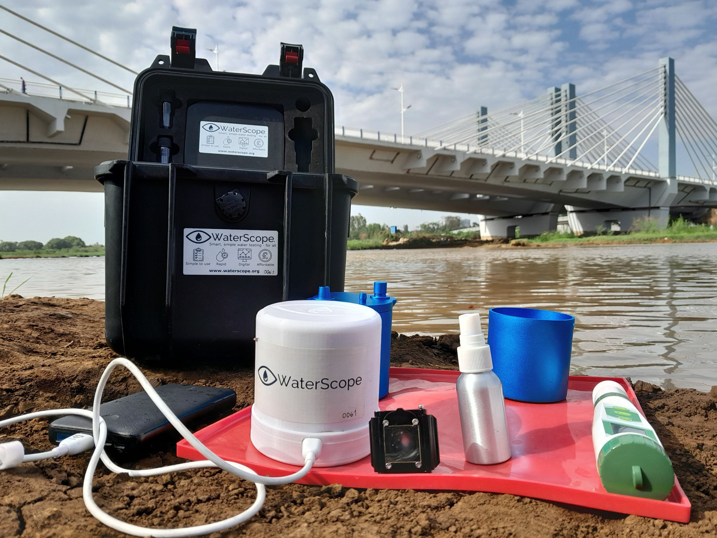
The WaterScope System
An open-source innovative water testing system, enabling inclusive access to smart, easy-to-use, and reliable testing for bacterial presence in drinking water.
Orginally developed by Cambridge University Engineers
Picture - Nile River, Bahir Dar, Ethiopia
Notes:
This is where WaterScope becomes relevant.
WaterScope is an open-source, field-adapted membrane filtration system originally developed by engineers at the University of Cambridge.
It simplifies bacterial testing in drinking water through a cartridge-based method, combined with automated colony detection using machine learning.
Instead of requiring a full laboratory, the system is compact, portable, and deployable in the field — as shown here by the Nile River in Bahir Dar.
It bridges laboratory-level accuracy with field accessibility.

Slide 5









Key Features of WaterScope System
Rapid
Reliable
Smart
Provides immediate results for water quality testing.
Provides consistent and accurate water quality results.
Provides real-time data for informed decision-making.
Portable
Robust
Affordable
Designed for easy transport to remote locations.
Designed to withstand challenging field conditions.
Designed to be cost-effective for local communities.
Simple
Digital
Data-Driven
User-friendly design ensures ease of operation.
Integrates advanced technology for data-driven insights.
Utilizes advanced analytics to improve water quality.
Notes:
But what makes it truly transformative are its features.
The system is rapid — providing early indication in as little as 8 hours and full quantitative results in 21 hours.
It is portable and simple — designed for low-resource environments.
It is reliable and robust — benchmarked against ISO 9308 standards and externally validated.
It is digital and smart — using embedded microscopy and machine learning to automate colony counting.
It is affordable — reducing financial barriers.
And most importantly, it is data-driven — enabling real-time monitoring and centralized reporting by using its mobile app and dashboard

Slide 6
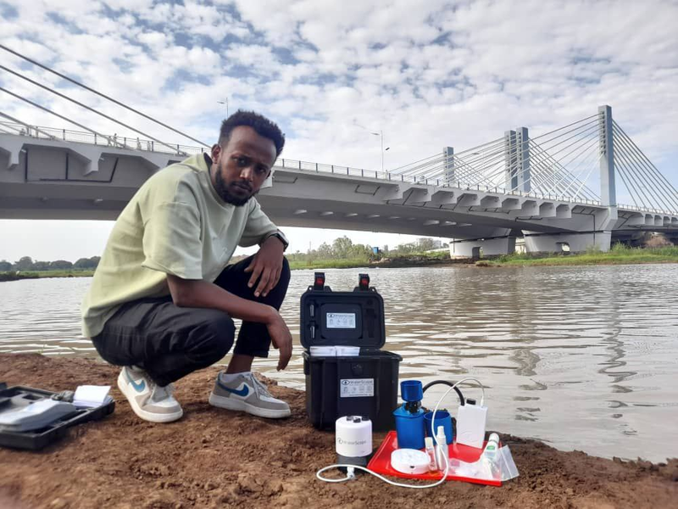
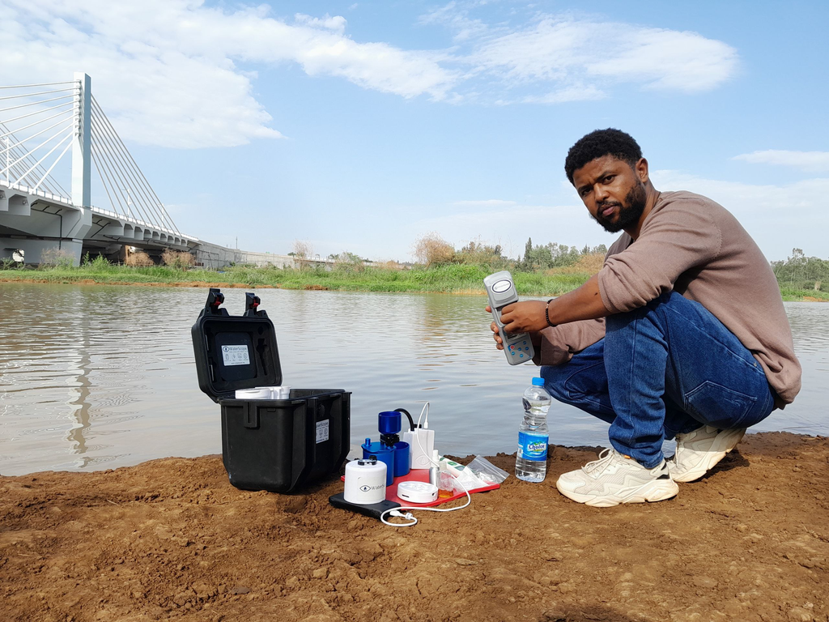
Our Committed Team
Building Local Capacity
We are a dedicated group of young Ethiopian engineers focused on enhancing local water diagnostics and fostering innovation through collaboration with communities and educational institutions.
Yohannes Tamiru
CoFounder and Technical Lead
Metmku Yohannes
CoFounder and Bussiness Lead
Notes:
However, technology alone is not enough.
We are a team of young Ethiopian engineers and entrepreneurs.
Our work is focused not only on deploying devices, but on building local technical capacity.
We collaborate with communities, government stakeholders, and universities — including Bahir Dar University.
Our goal is to ensure that diagnostic capacity is built locally, sustained locally, and scaled locally.
African-led innovation is central to our model.

Slide 7
Cost Reduction
What Makes Us Different
Local manufacturing significantly lowers costs by up to 80%, making water testing accessible to communities in need.
Capacity Building
Our approach builds local technical and research capacity, empowering communities to take control of their water quality solutions.
Self-Reliance
Strengthening local capacity ensures communities can manage their water resources effectively and sustainably over time.
Job Opportunities
Creating local manufacturing jobs empowers individuals and stimulates economic growth in regions affected by water scarcity.
Notes:
This leads to what makes our approach different.
What differentiates us is not only the device — but the systems innovation model.
Through local manufacturing, we reduce costs by up to 80 percent.
We build technical and research capacity within the country.
We strengthen self-reliance by reducing dependency on imported diagnostics.
And we create local jobs in manufacturing and technical services.
This shifts water testing from external dependency to regional resilience.

Slide 8


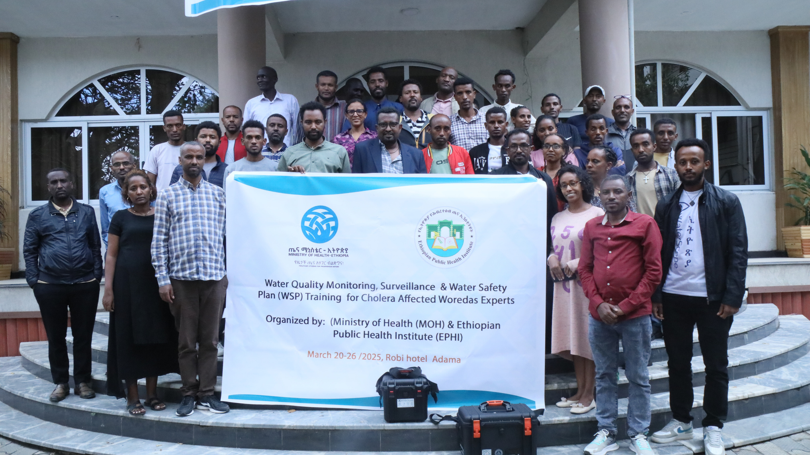

Traction & Institutional Confidence
Letter of Intent
Ministry of Health Engagement
Formal Letter of Intent received for up to 30 units under consideration from Action Against Hunger(ACF)
Active training programs for water testing technicians, building government capacity and demonstrating system usability.
Prior Pilots in Ethiopia & Kenya
Successful field testing and validation in East African contexts
Notes:
And we are already seeing traction.
We have received a formal Letter of Intent from Action Against Hunger for up to 30 units under consideration.
The system has been piloted in Ethiopia and Kenya, demonstrating field usability in East African contexts.
We are actively engaging the Ministry of Health through technician training programs, building government capacity.
These early institutional validations demonstrate confidence in both the technology and the model.
But our vision extends beyond Ethiopia.

Slide 9
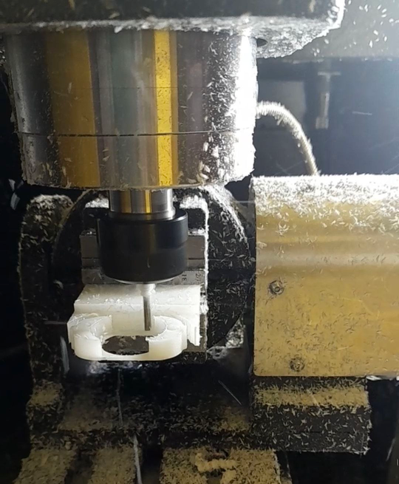
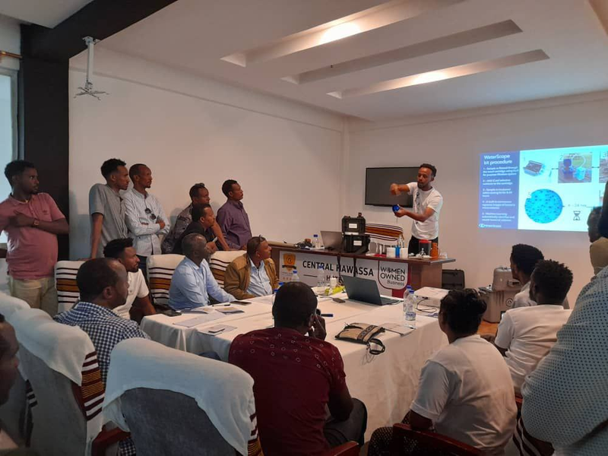
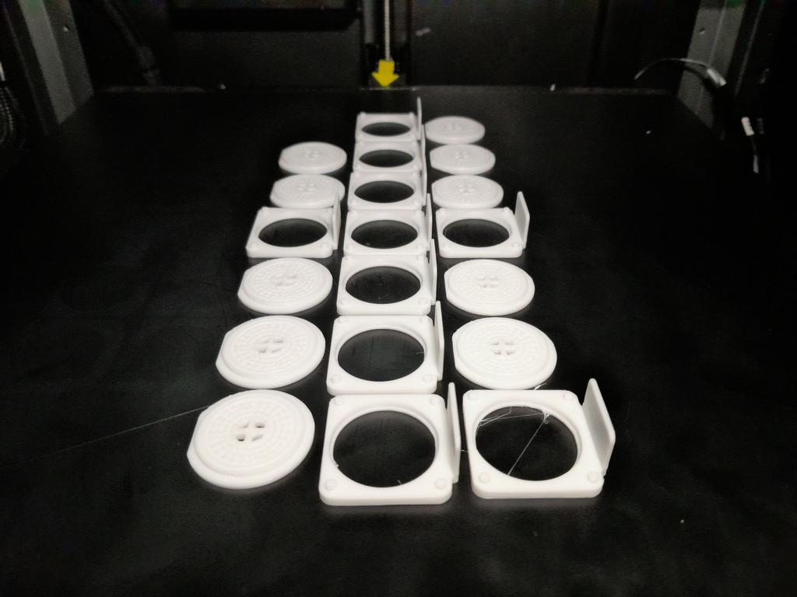
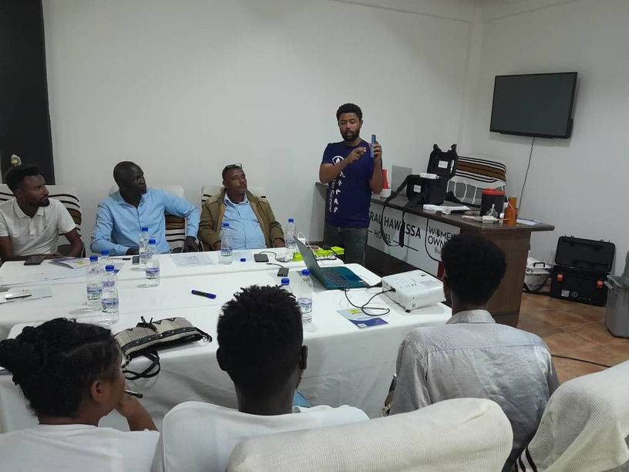
Early Progress
Manufacturing and Training
Notes:
We have begun local manufacturing using 3D printing and machining technologies.
We conduct training programs for water technicians.
And we are building partnerships across sectors.
This is the beginning of a localized diagnostic ecosystem.

Slide 10
Scale & Deployment
The Collaboration Invitation
Partner on pilot programs, regional rollouts, and integration with existing water quality monitoring systems.
Partnership in Africa
We are interested in collaborating with organizations in African nations that are actively engaged in water testing initiatives.
Notes:
And now, we invite collaboration.
We are open to collaboration in research, scale, and deployment.
This platform enables work in environmental microbiology, antimicrobial resistance surveillance, AI-driven pathogen detection, and implementation science.
We invite Canada–Africa academic collaboration — joint grants, co-supervision of students, pilot programs, and regional deployment strategies.
Water surveillance should be equitable, collaborative, and locally empowered.

Slide 11



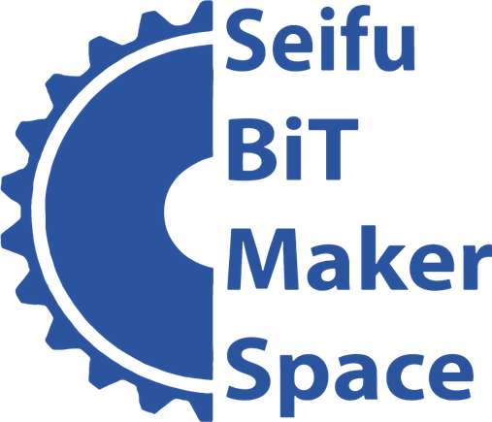

Our Partners
Notes:
And we are grateful for the partners who support this journey.
We work closely with Bahir Dar University, Centre for Global Equality, BiT Maker Space, and the founders WaterScope.
These partnerships strengthen both technical rigor and implementation capacity.
Collaboration is at the heart of our progress.

Slide 12
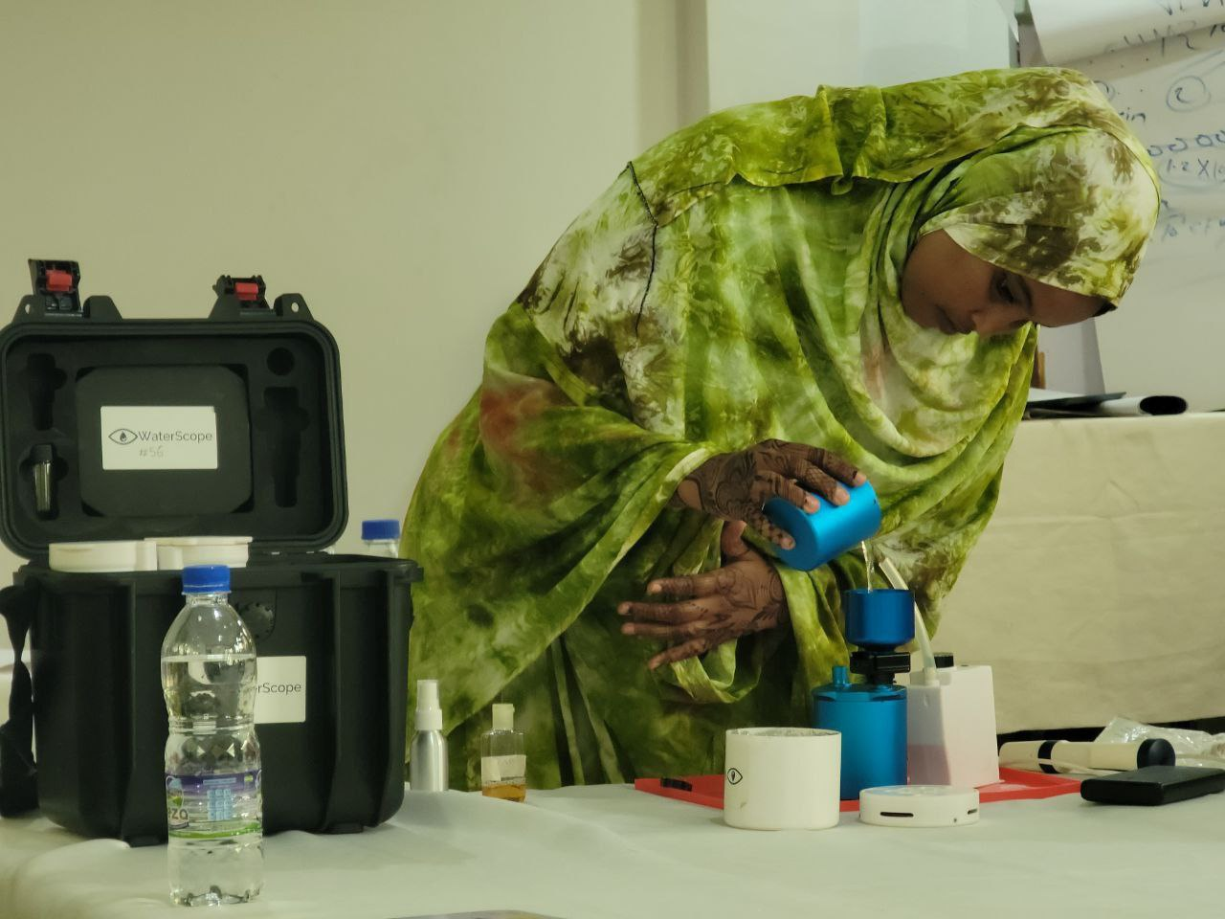
Get in Touch
Join us in transforming water quality surveillance through local innovation.
Phone: +251-943-506510, +251-945-552214
Email: social@watereth.com
jotamiru112@gmail.com
metmkujohn@gmail.com
LinkedIn: WaterScope Eth
Notes:
I will close with this thought.
Water quality surveillance should not depend solely on imported laboratories.
Young African engineers can build scalable, validated, research-driven solutions.
Through equitable academic collaboration, we can transform water safety monitoring across Africa.
Thank you — and I welcome your questions.

